Slide 1
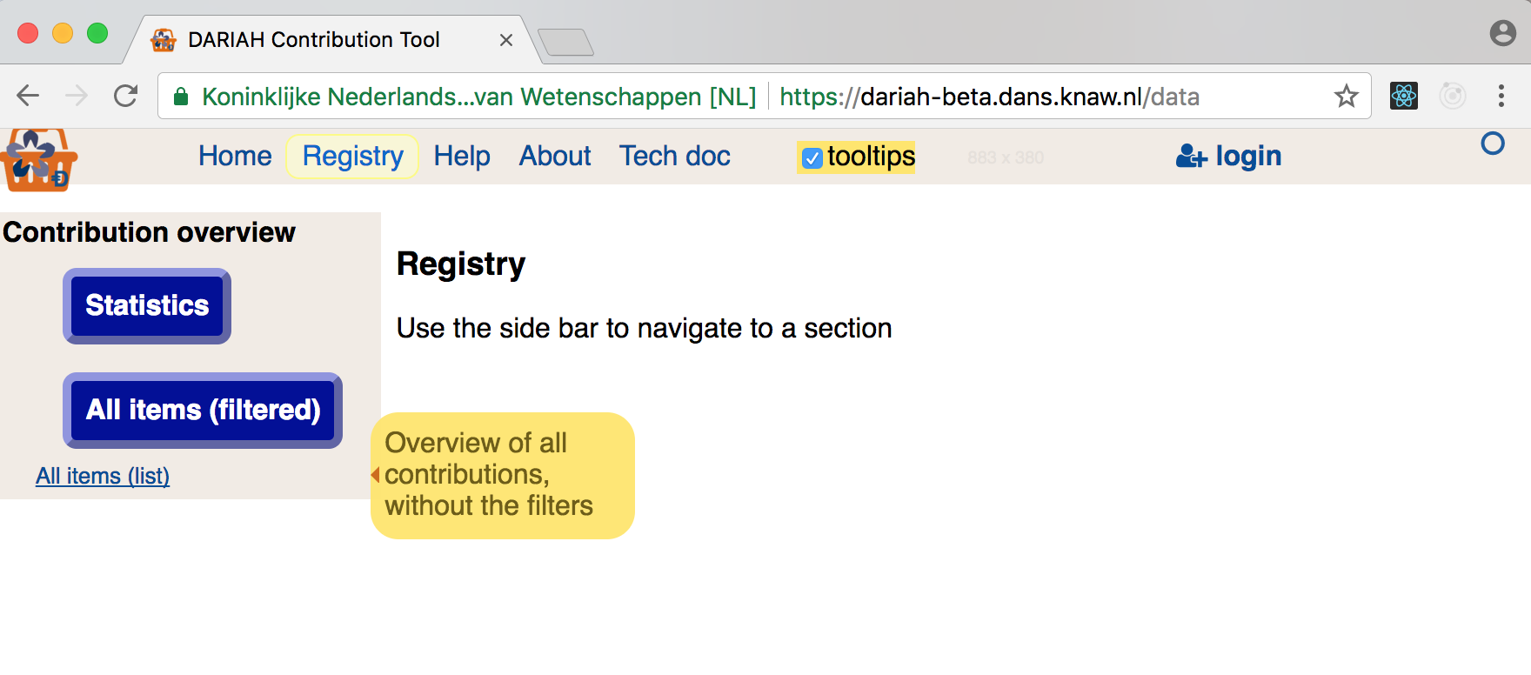
entering
not yet logged in ... tooltips can be switched off ... big buttons for usual actions ...

Slide 2
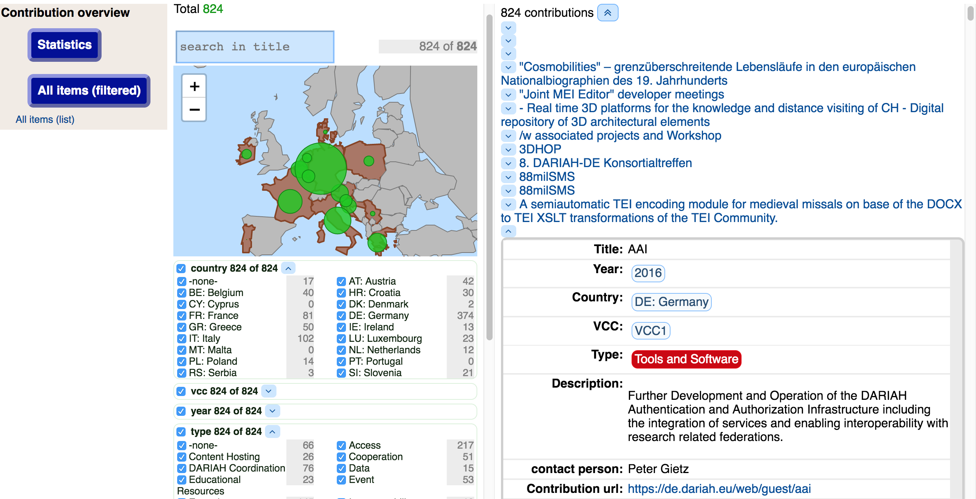
public view
contributions are public ... can be filtered on all metadata ... view individual ones

Slide 3
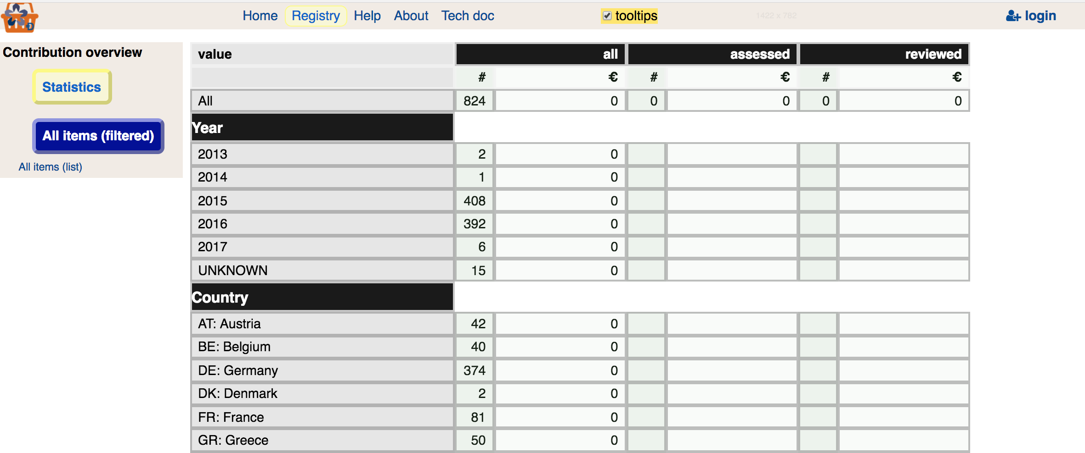
statistics (public)
no cost information when not logged in

Slide 4
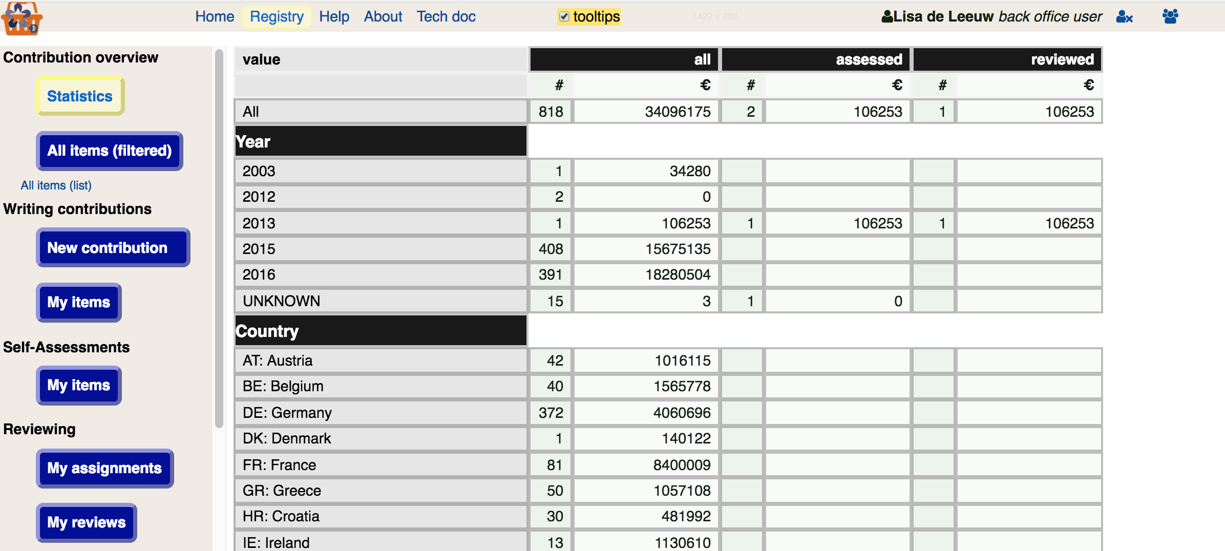
statistics (office)
much more info when logged in as office

Slide 5

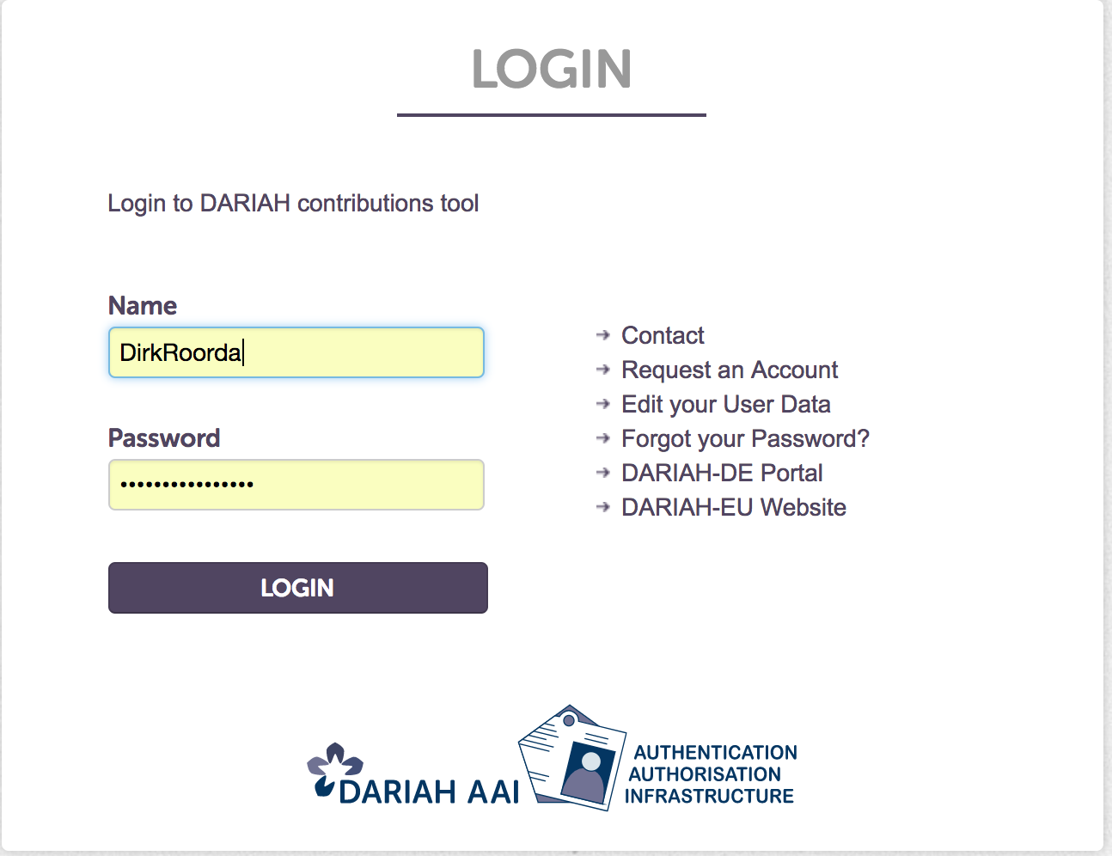
DARIAH login
DARIAH knows where you work ...

Slide 6
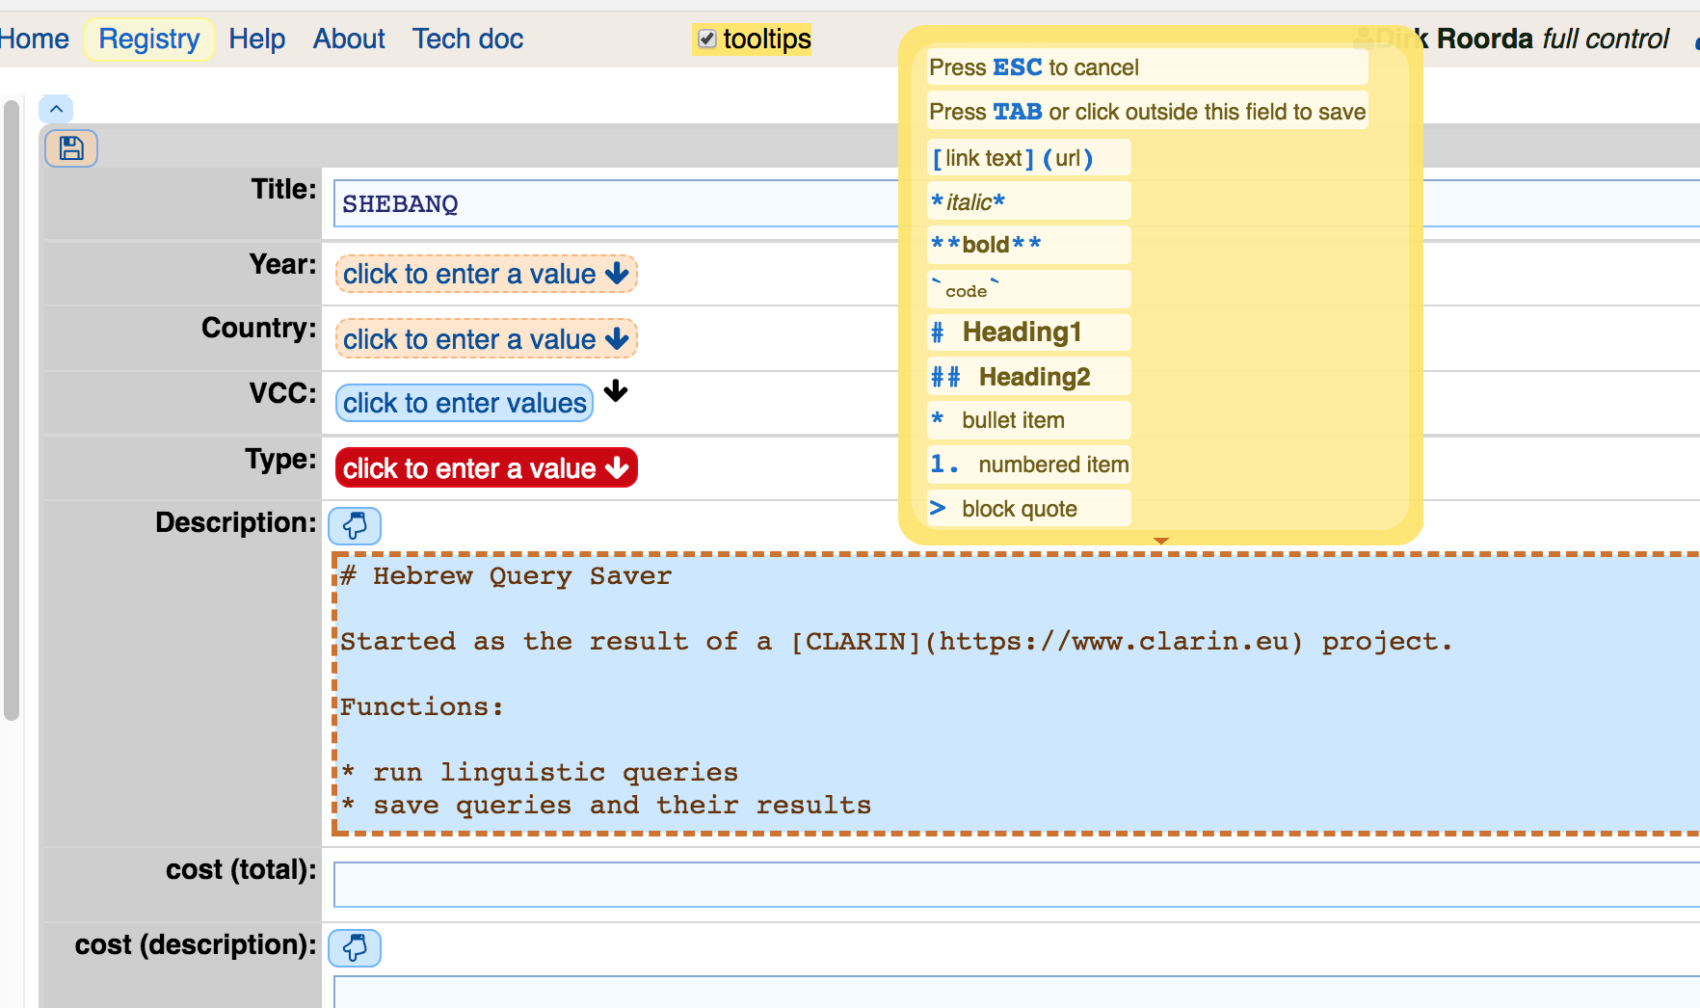
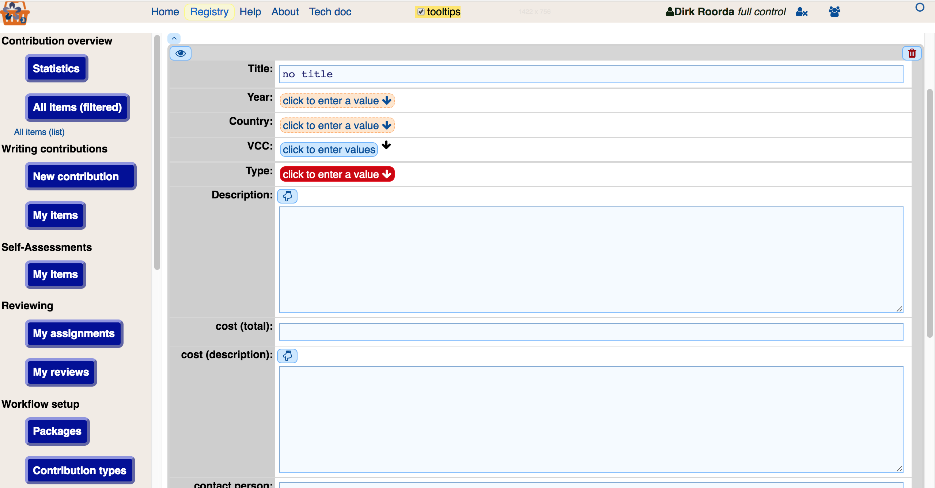
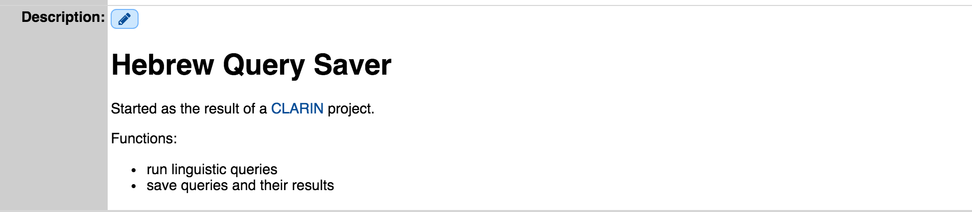
new contribution
start with the big button ... enter rich text (markdown) ... and preview

Slide 7
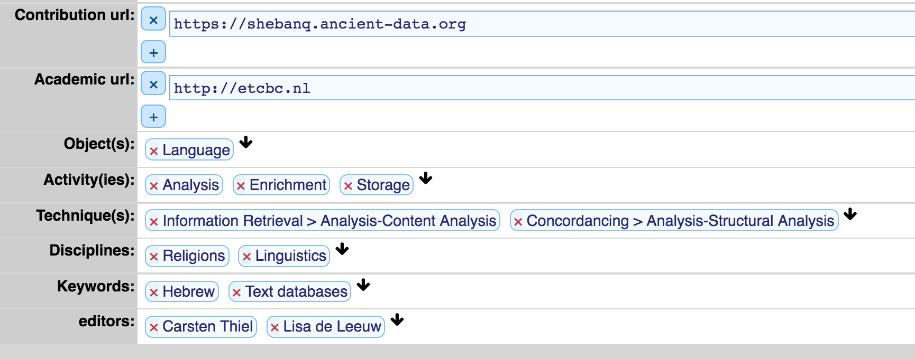
ownership
you, as creator, can assign additional editors
the office can assign editors to legacy contributions
it also works for assessments, reviews, and nearly everything else
what you write is what you own ... but you can transfer to editors ...

Slide 8
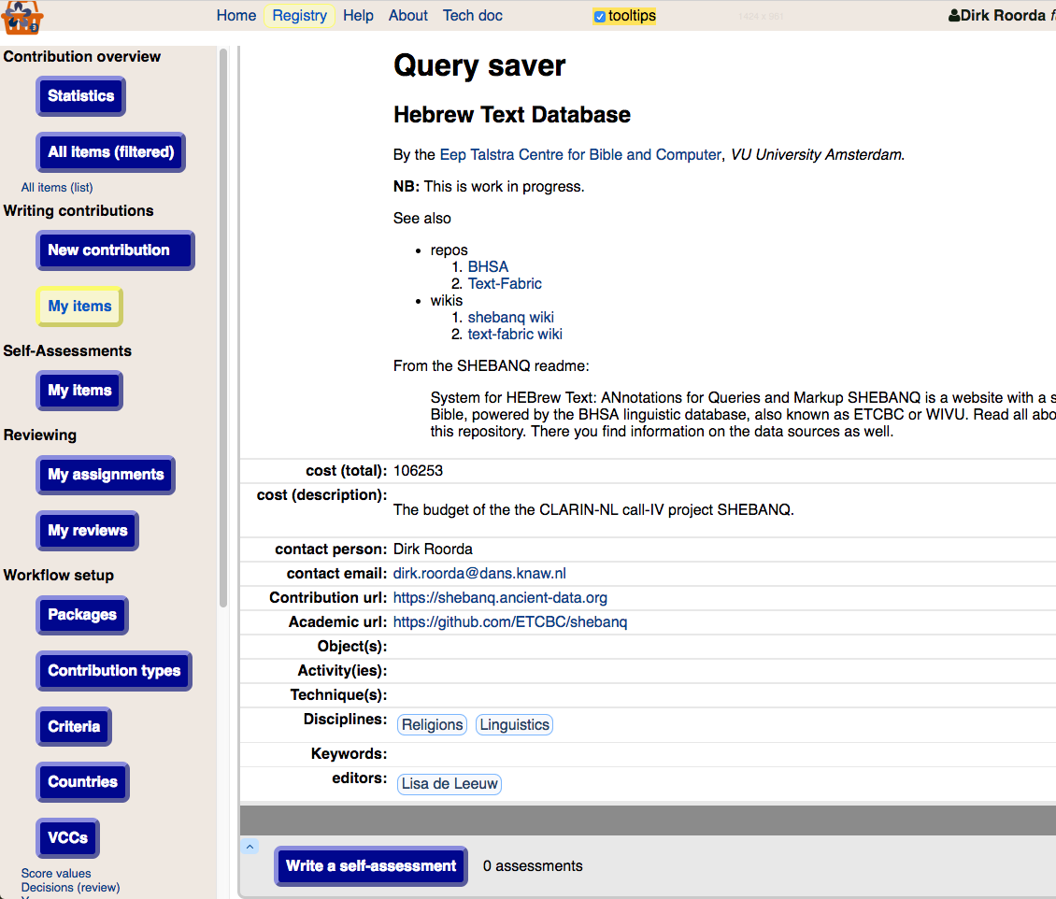
self-assessment
go to my items ... select contrib ... click the big button

Slide 9
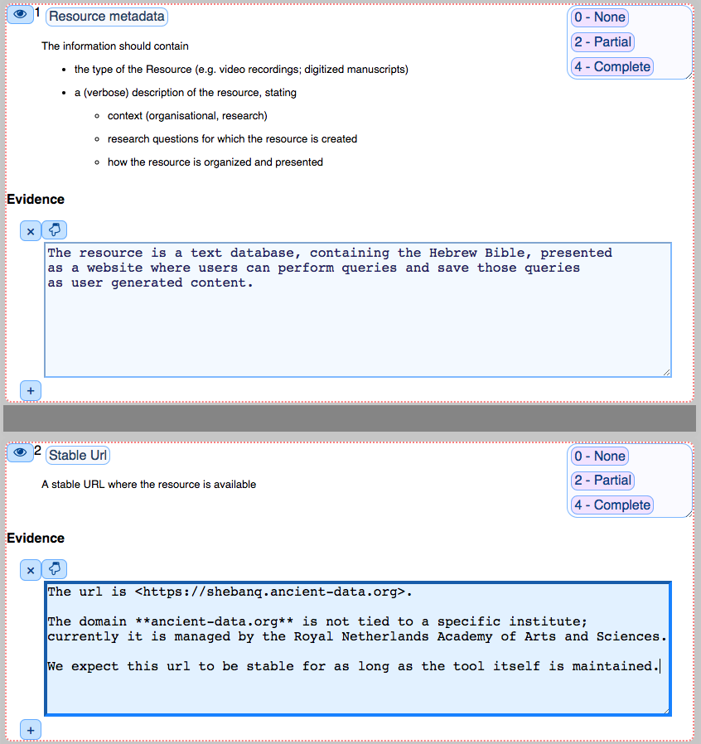
assess the criteria
the relevant criteria have been assembled ... based on contribution type

Slide 10
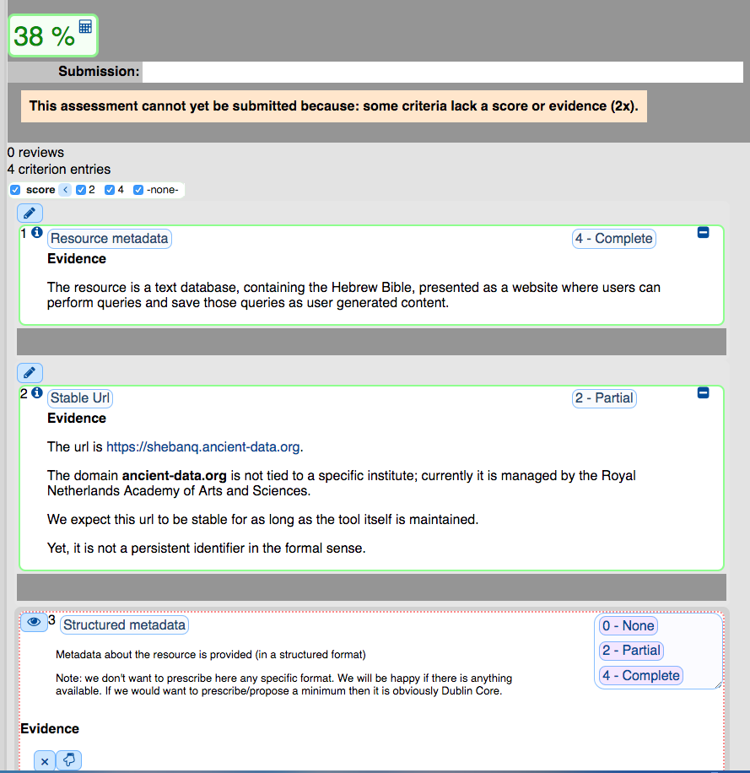
mind the scores
move on to the next criteria ... keep an eye on the score

Slide 11
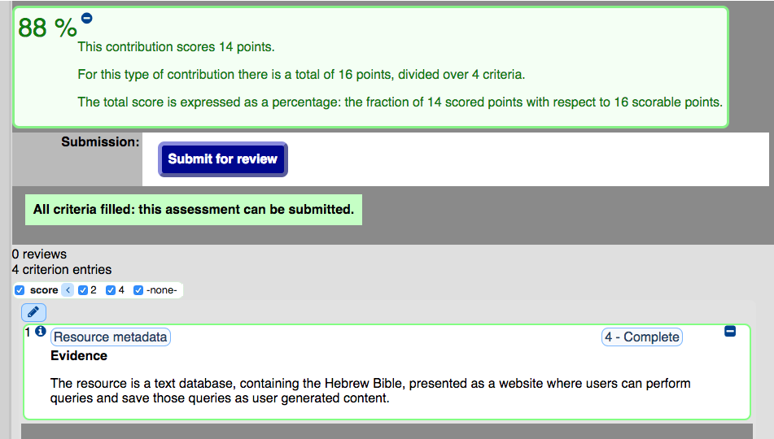
completing an assessment
before submit ... check out the score ... and its derivation

Slide 12
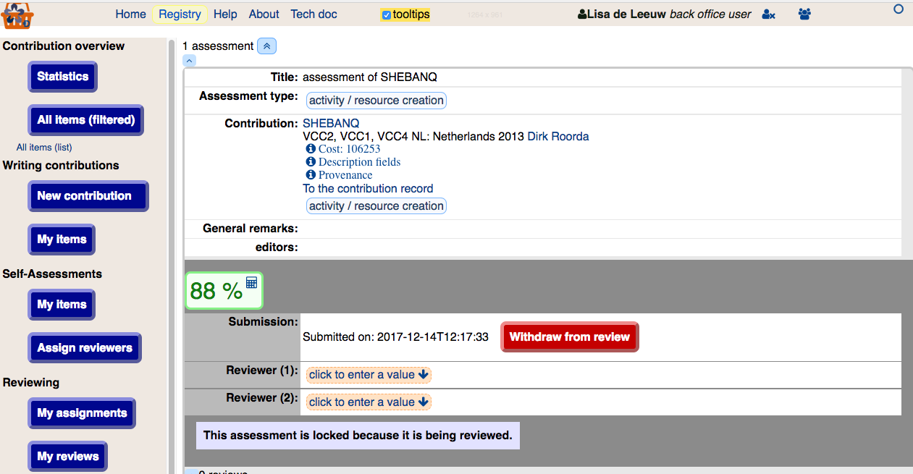

assign reviewers
office assigns reviewers

Slide 13
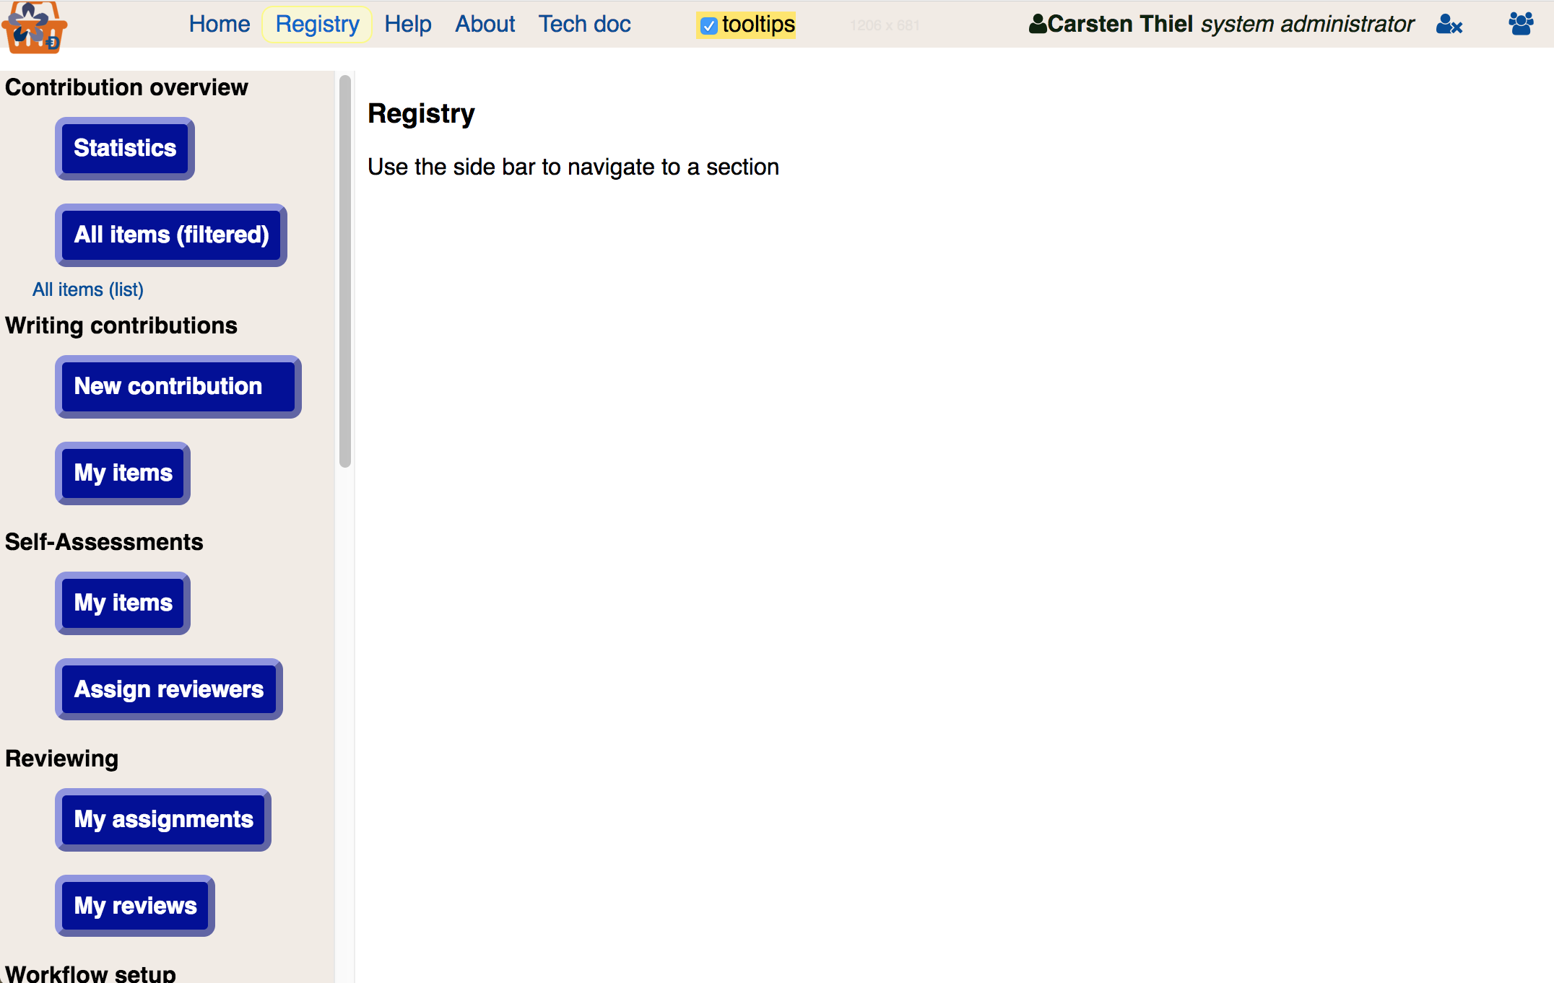
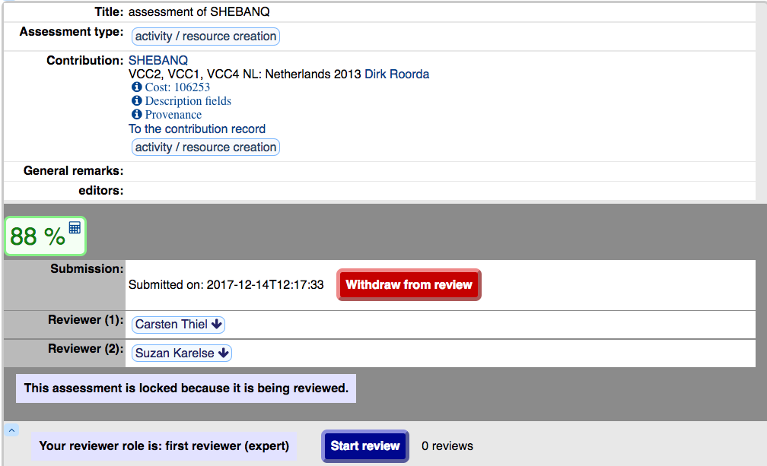
first reviewer
first reviewer starts ... this reviewer is sysadmin ... that’s why the withdraw shows up

Slide 14
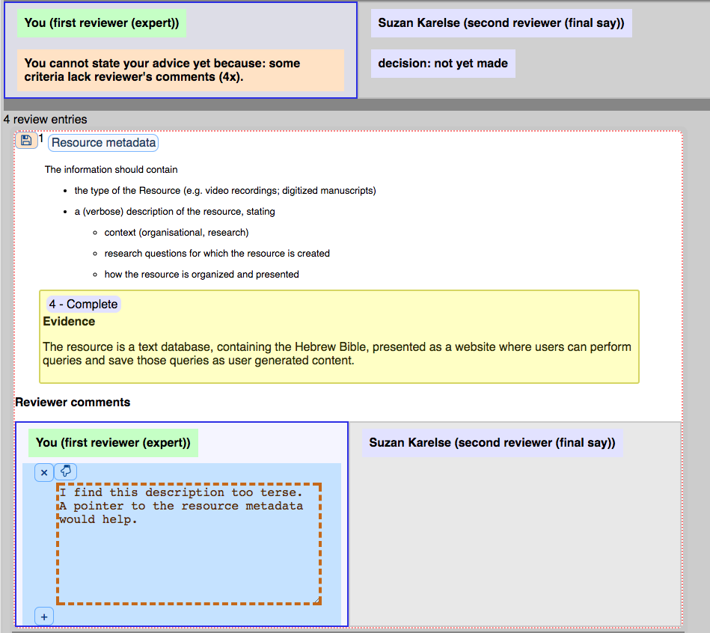
commenting criteria-wise
see the criterion ... the evidence by the assessor ... write your comments

Slide 15
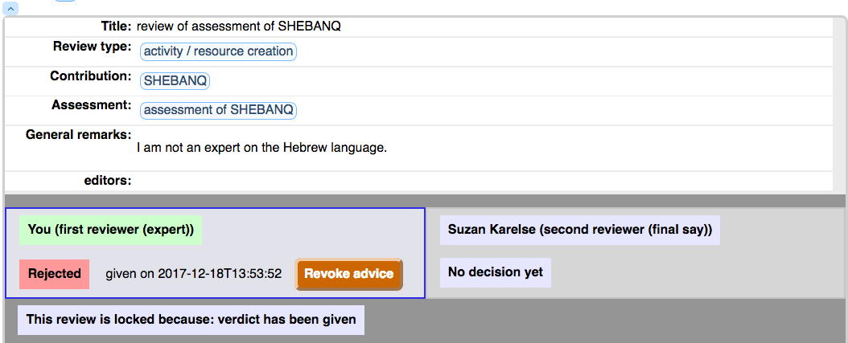
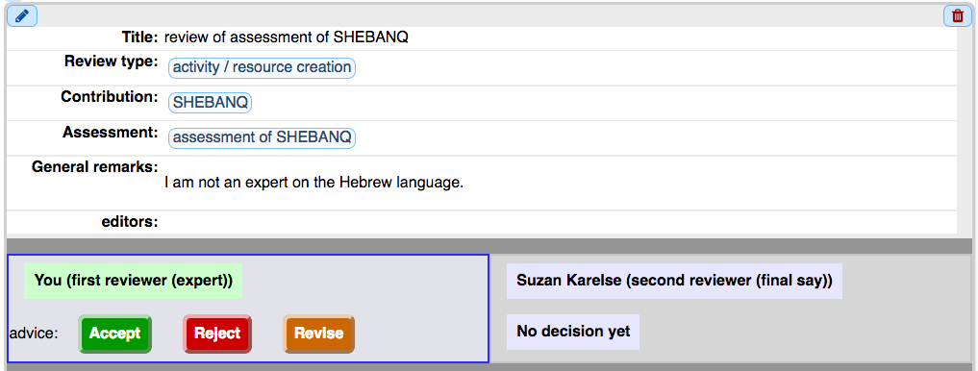
first reviewer: advice
finish the first part of the review by giving advice

Slide 16
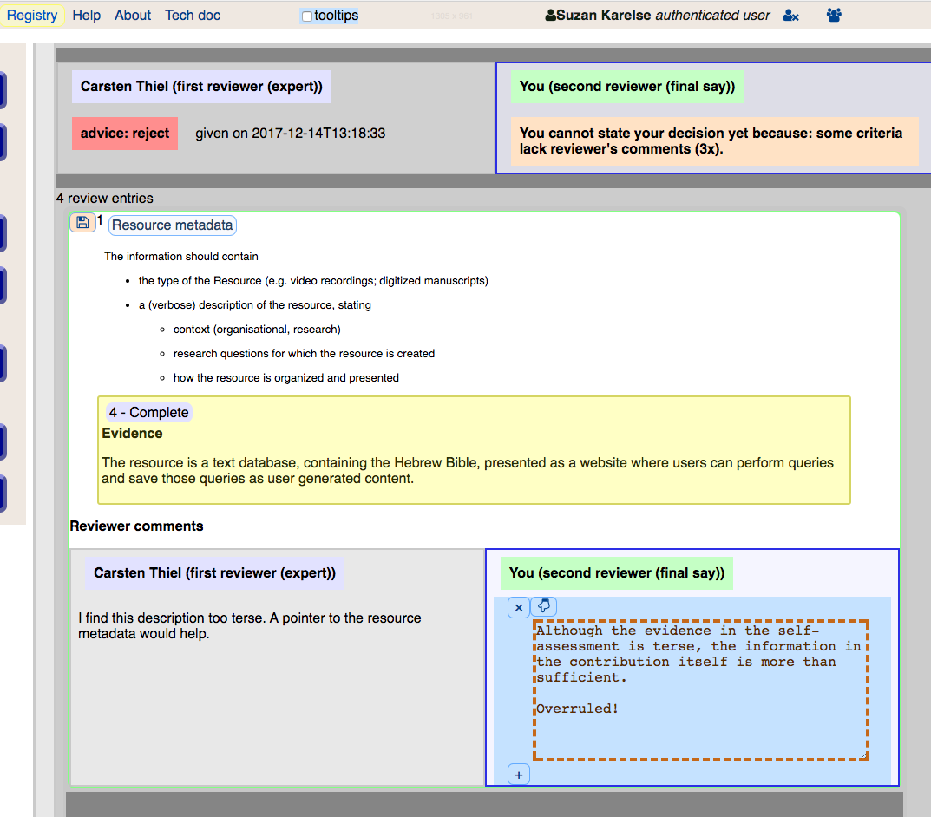
second reviewer
both reviews are separate docs ... separate owners ... peeking into each other’s text

Slide 17
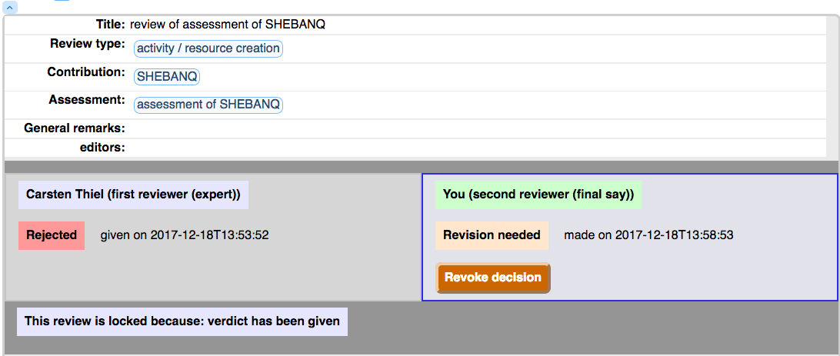
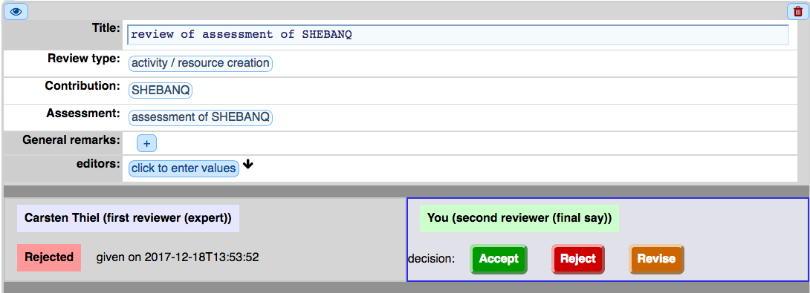
second reviewer: decision
finish the review by making a decision ... overruling the advice (in this case)

Slide 18
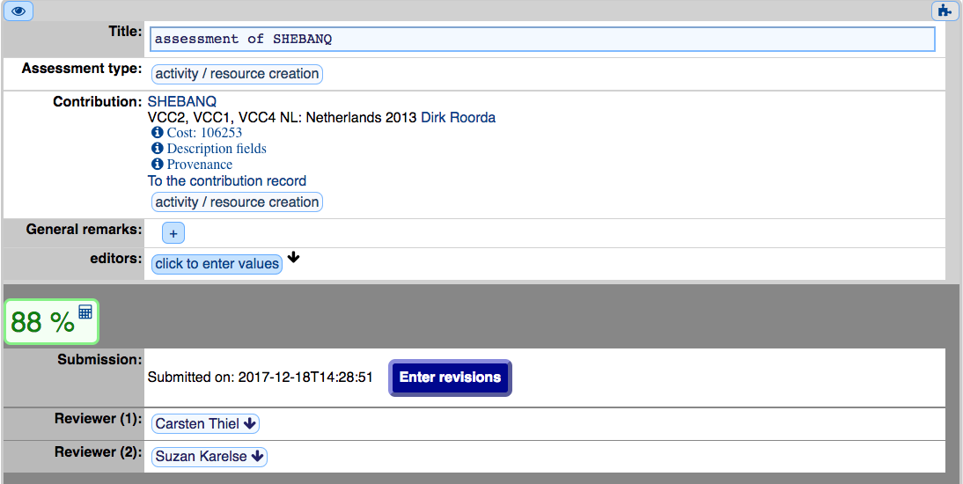
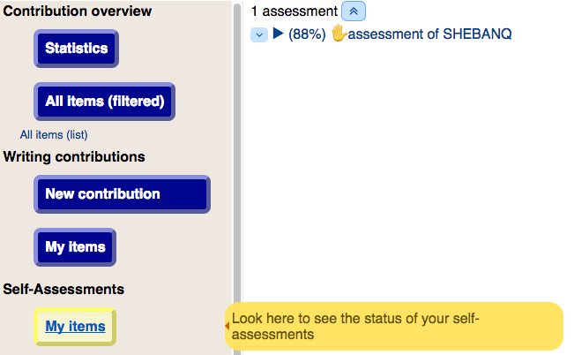
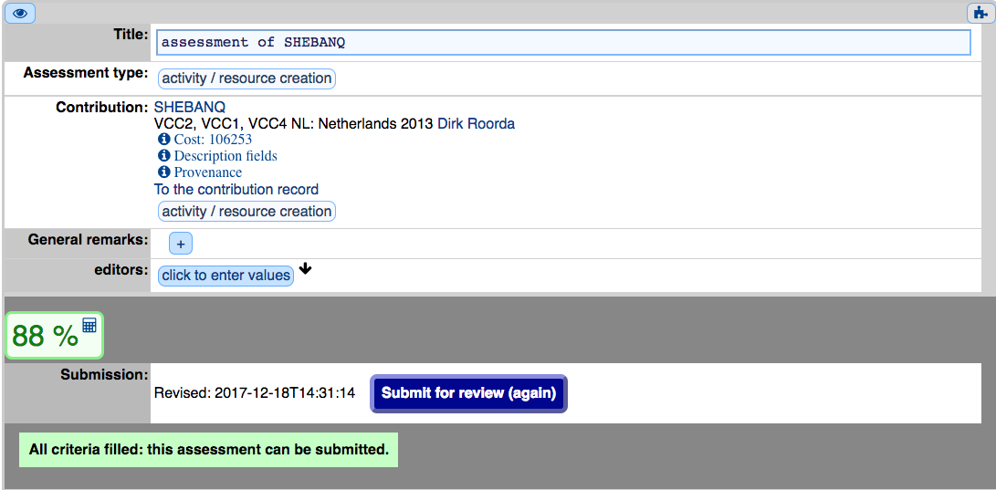
back to the applicant
applicant re-opens assessment ... makes corrections ... re-submits it

Slide 19
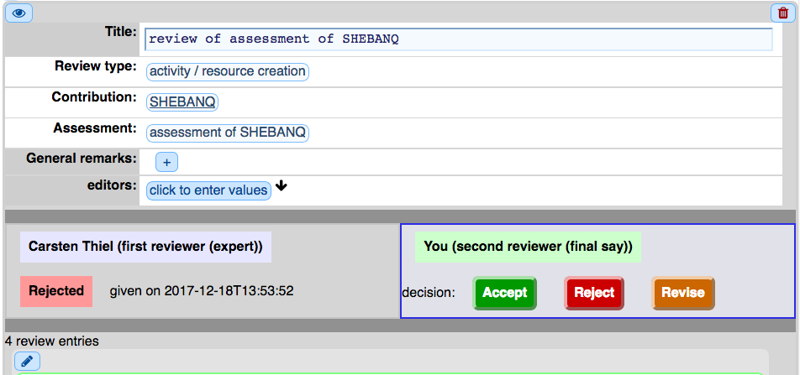
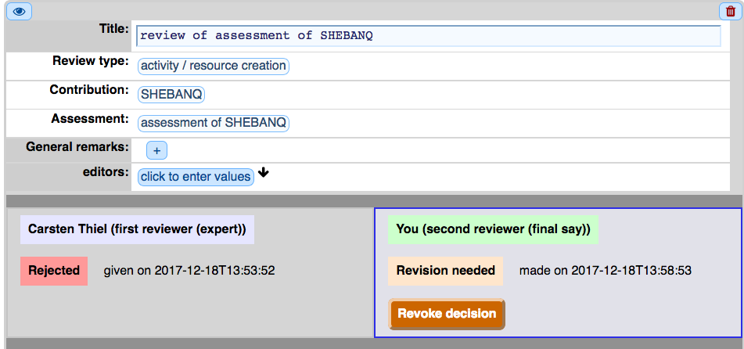
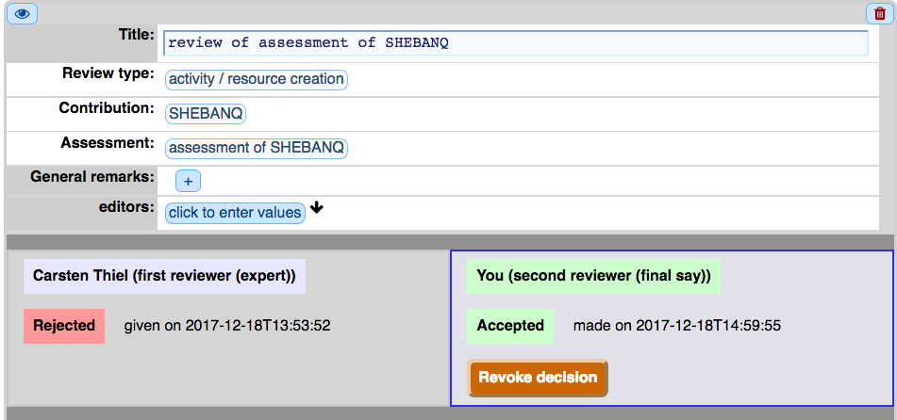
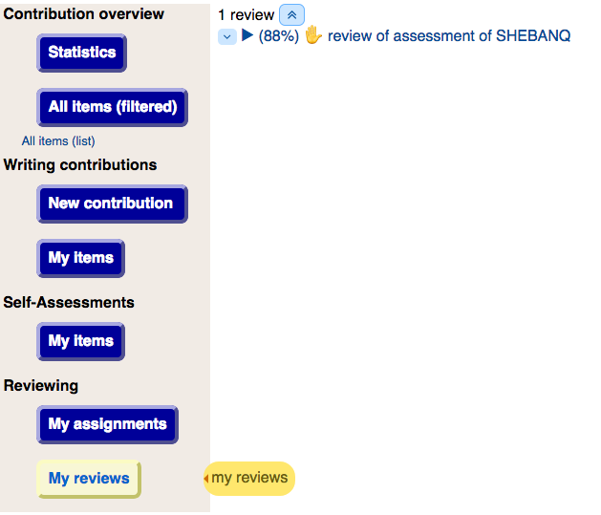
second reviewer: new decision
reviewer checks ... revokes previous decision ... makes new decision

Slide 20
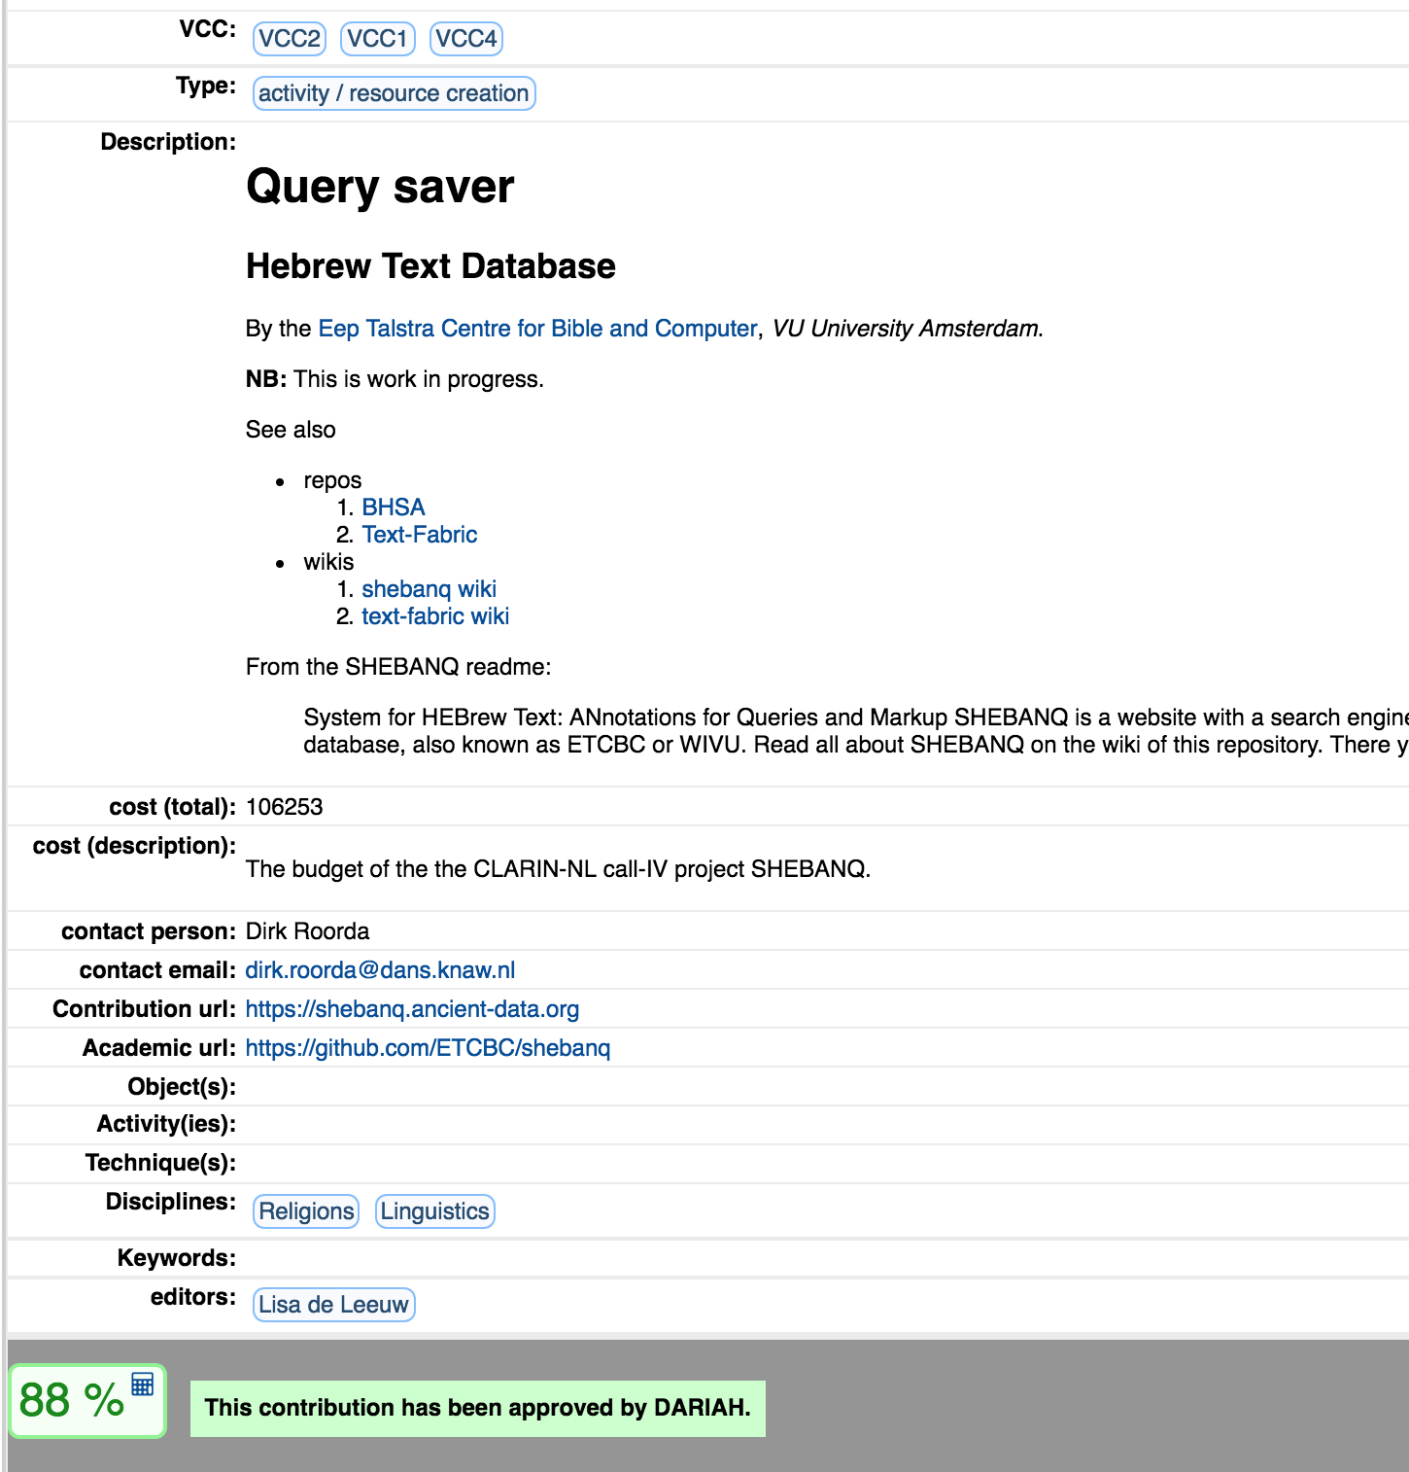
DARIAH seal of approval
we look at an approved contribution ... the score is public

